Slide 1
Tutorial 7
Ionic Framework March 2, 2017
CS 5551 Advanced Software Engineering
UMKC

Slide 2
What is Ionic ?
“Ionic is the beautiful, open source front-end SDK for developing hybrid mobile apps with web technologies.”
-- ionicframework.com
Angular JS is the heart of Ionic SDK.
All the logic is written using Angular JS and Ionic acts as a bridge between the native application and web development.
Can develop applications for Android and iOS.

Slide 3
Setup
Step 1: Install Android SDK
Step 2: Install Angular JS & Ionic extensions in Adobe brackets
Step 3: Install Visual studio code
Step 4: Install node js
Step 5: Install ionic command line tools
More Info : http://ionicframework.com/docs/guide/installation.html

Slide 4
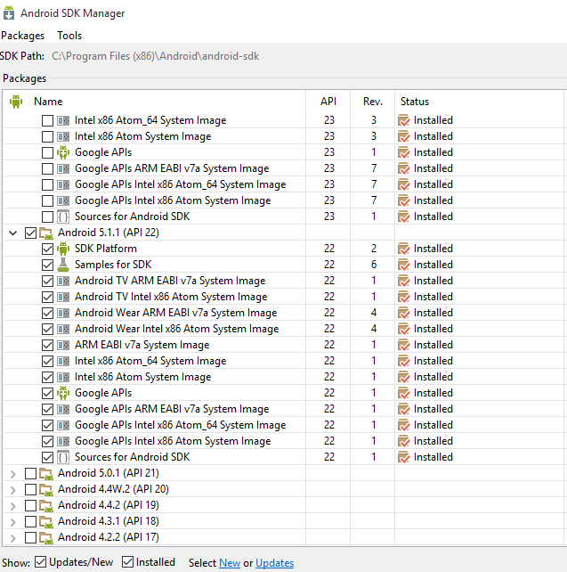
Install Android SDK
https://developer.android.com/sdk/installing/index.html?pkg=tools
Install Android 5.1.1 using SDK manager.
Open AVD Manager and create a virtual device. Please choose Android 5.1.1 version for the device.

Slide 5
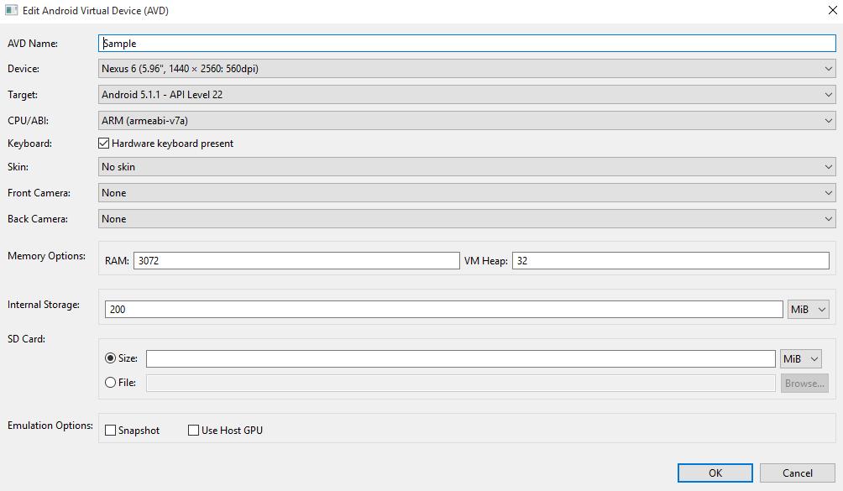
AVD Manager
There are different settings for creating a virtual device, just like when you shop for a new Android mobile.
Please choose target <= Android 5.1.1 version
CPU - arm

Slide 6


Code Editors
Brackets Visual Studio Code
Better HTML editing in Brackets Better JS code hints in Visual Studio Code.
vs

Slide 7
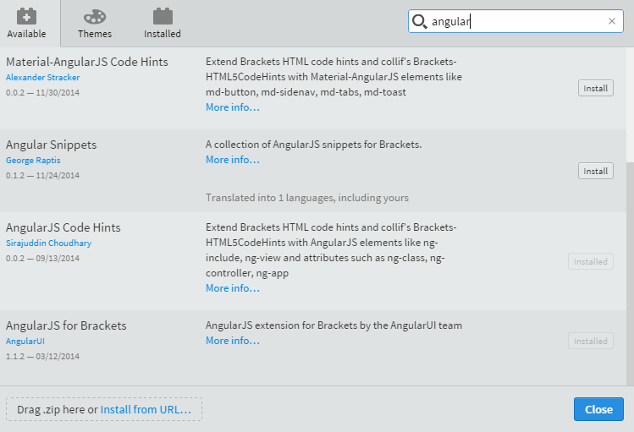
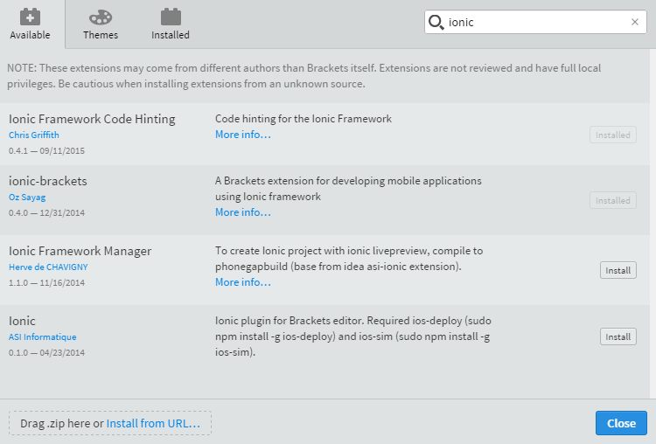
Brackets
Install the following extensions in adobe brackets for a better developer experience:
AngularJS Code Hints
Angular JS for Brackets
ionic-brackets
ionic Framework Code Hinting
Simple JS Code Hints

Slide 8
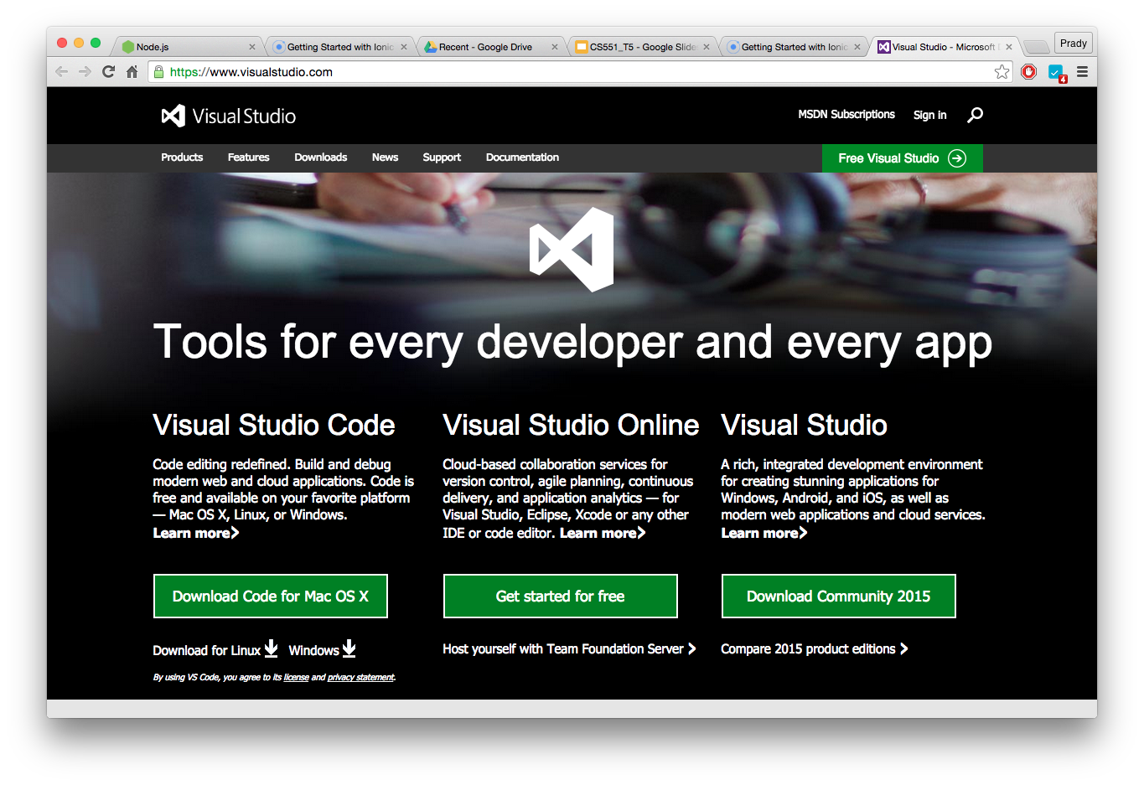
Visual Studio Code
https://www.visualstudio.com/
Download “Visual Studio Code”

Slide 9
npm(node package manager)
Default package manager for the JavaScript runtime environment Node.js.
Installed automatically with the environment.
npm is written entirely in JavaScript
It installs the packages you want to use and provides a useful interface to work with them.
Online repository for the publishing of open-source Node.js projects.
Command line utility to install Node.js packages
https://docs.npmjs.com/getting-started/what-is-npm

Slide 10
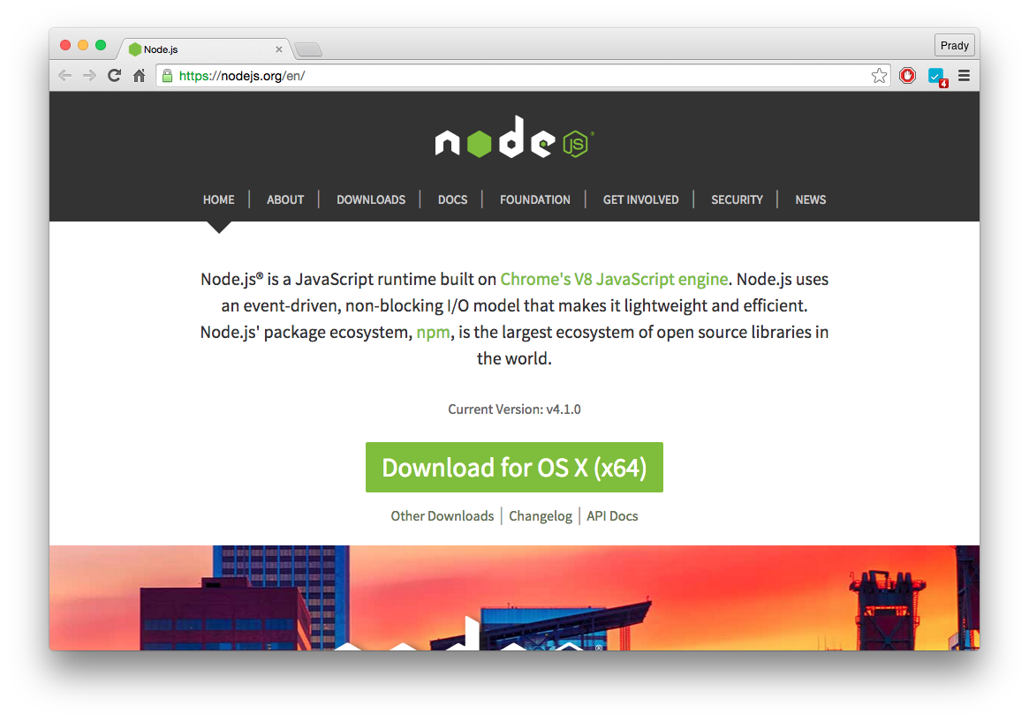
node js installation
Download the system specific build.
https://nodejs.org/en/

Slide 11
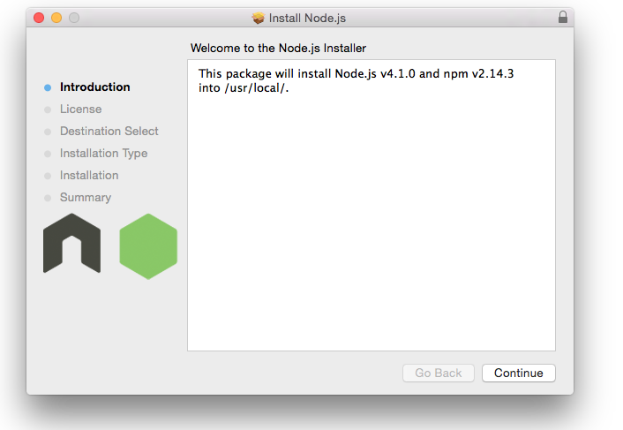
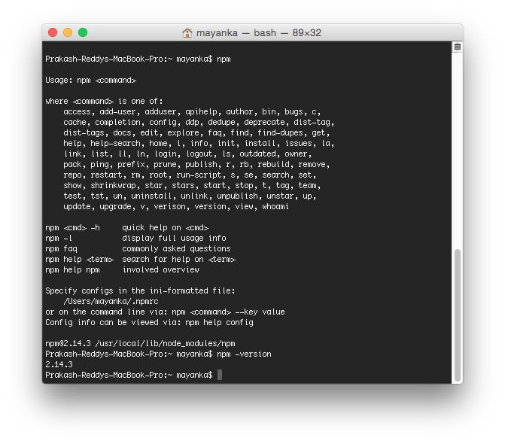
node js Verification
Open terminal/command prompt and type “npm” or “npm -v” to check the installation.

Slide 12
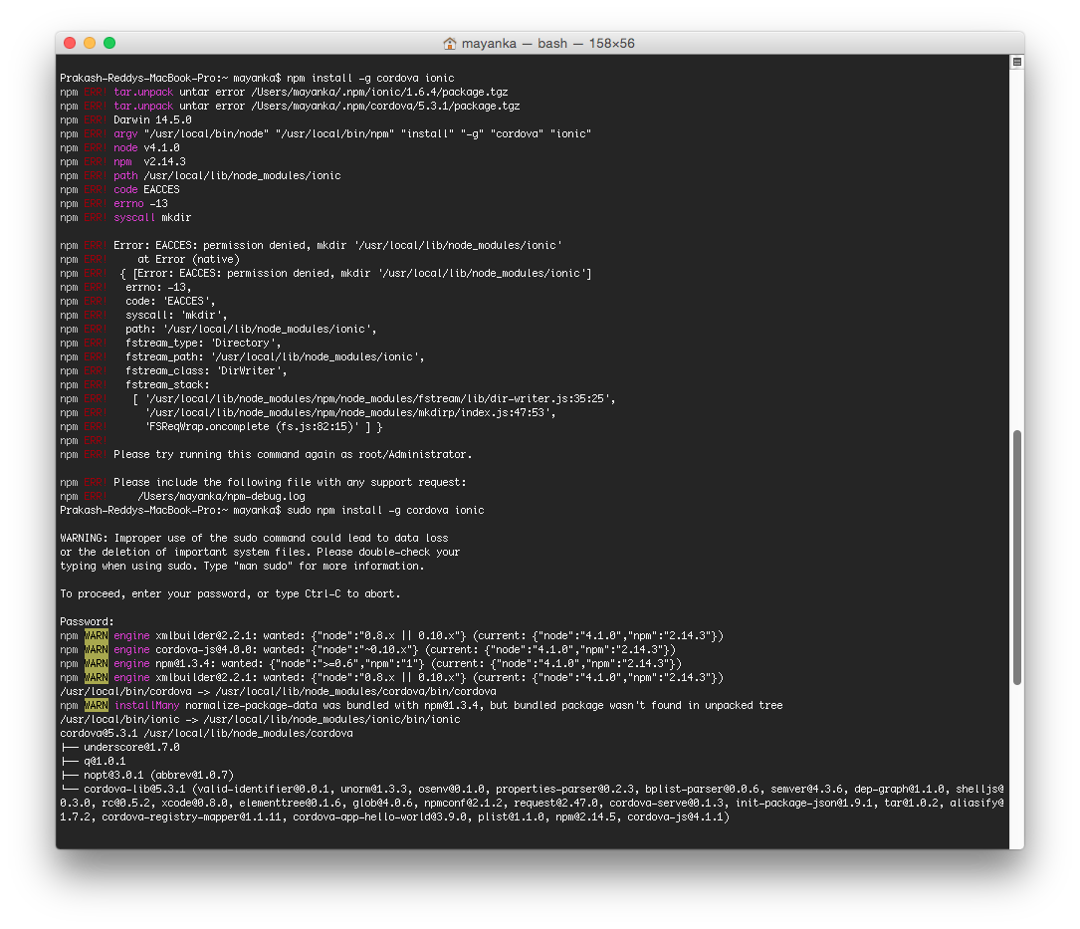
Install Ionic
Command
npm install -g cordova ionic
All unix based OS users, don’t forget to use the mighty “sudo”

Slide 13
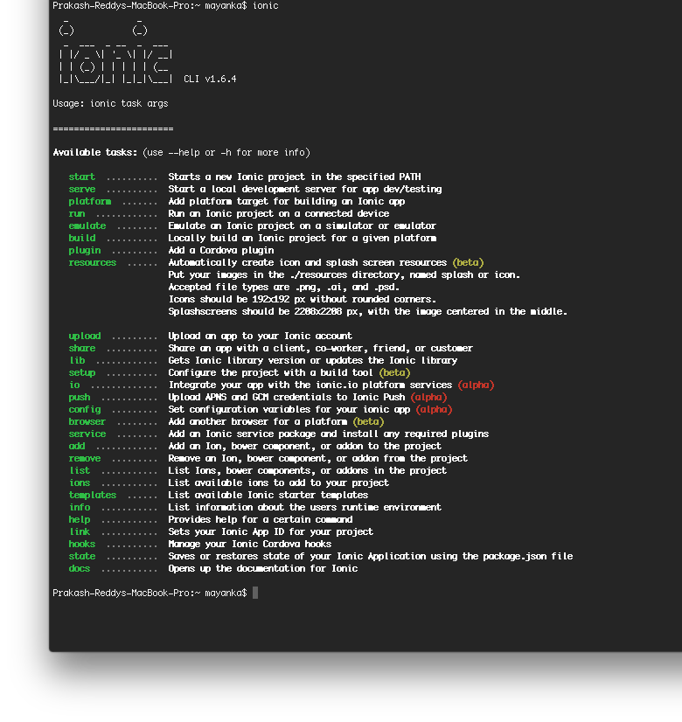
Ionic verification
There are different options for the command “ionic”
There are different types of app templates available . (next slide)

Slide 14
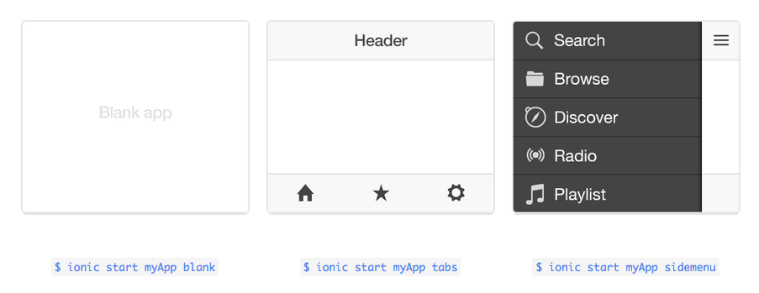
Ionic App types

Slide 15
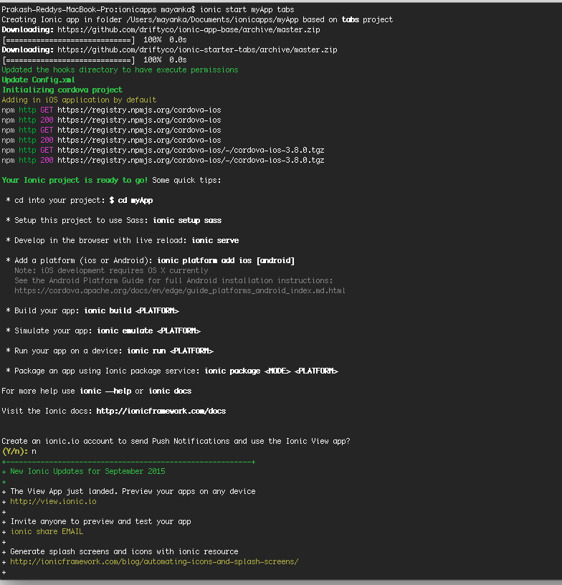
Ionic App Creation
To create an app
ionic start myApp tabs
There are different types of app templates available . (next slide)
App name (a folder shall be created using this)
Template type

Slide 16
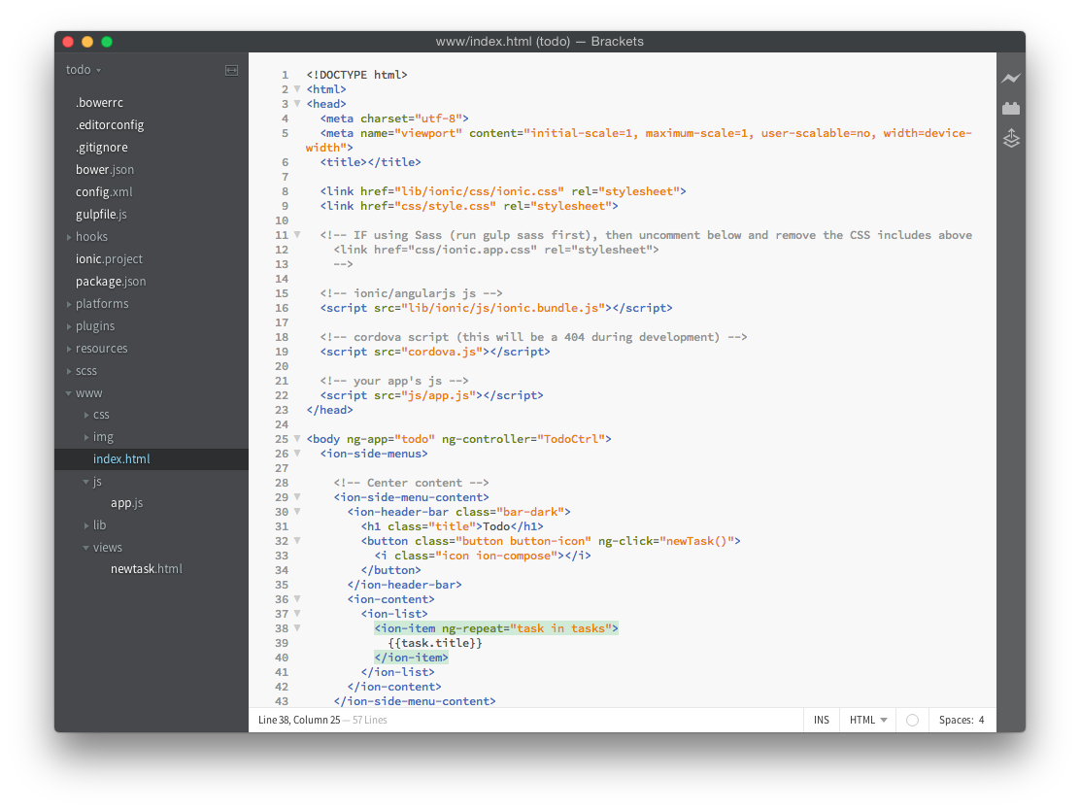
Open the App created in Adobe Brackets
All the development work shall be done using this editor.
Before writing any code, let us run the application which we’ve created for the first time.

Slide 17
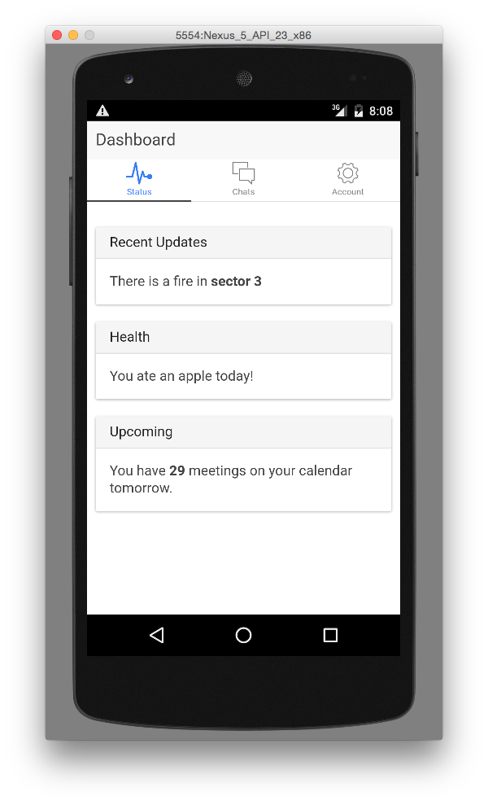
First Sample Run
$ cd myApp $ ionic platform add android $ ionic build android $ ionic emulate android
A sample application running with “tabs” template.

Slide 18
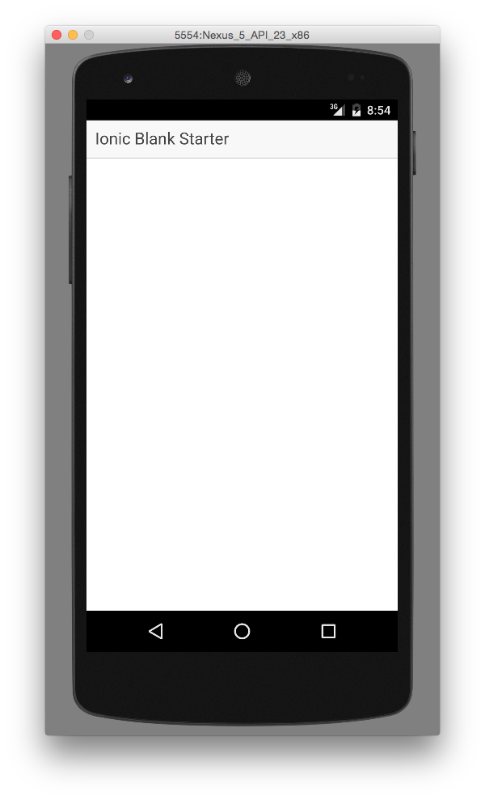
“To Do” Application
ionic start todo blank
Note: This time we are going to take a blank template unlike the first sample app.
To do application is used to show a list of to do items.

Slide 19
Folder Structure
platforms - contains your iOS and Android projects
hooks - for custom actions to be taken as your app moves through the Cordova development process
plugins - Cordova stores the plugins that you add to your project. Plugins are added by the command:
ionic plugin add {plugin}
www - is where your app is developed

Slide 20
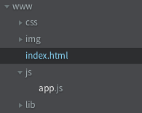
www structure
css - project specific css files
img - all the images
js - js files to be used in project
lib - libraries like angular js are stored here

Slide 21
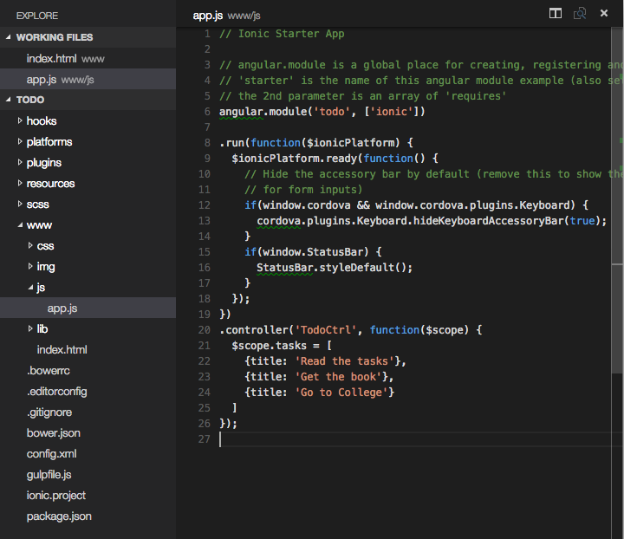
Controller Creation
TodoCtrl is a controller which shows the tasks.
tasks is the variable which is initiated with a temporary tasks.
$scope is the variable provided by angular js framework.

Slide 22
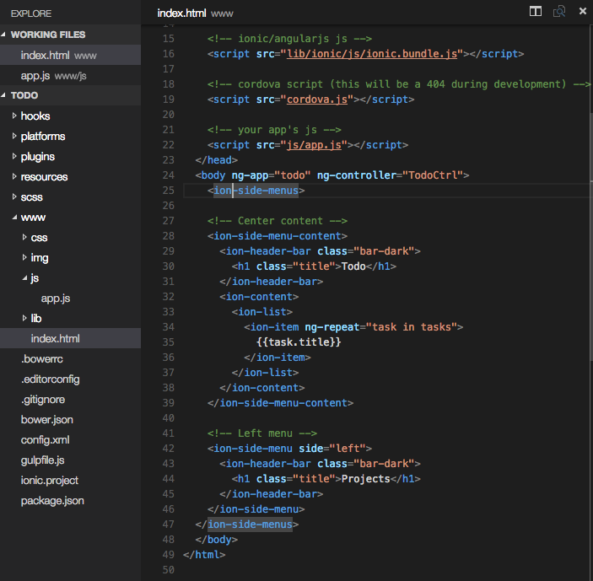
Include View for Showing Tasks
index.html has all the views to be shown
ion-list is a list
ion-item is a tag to show single item in ion-list.
ng-repeat is similar to for loop in front-end
To show a variable use “{{var_name}}”
Types of components in Ionic http://ionicframework.com/docs/components/

Slide 23
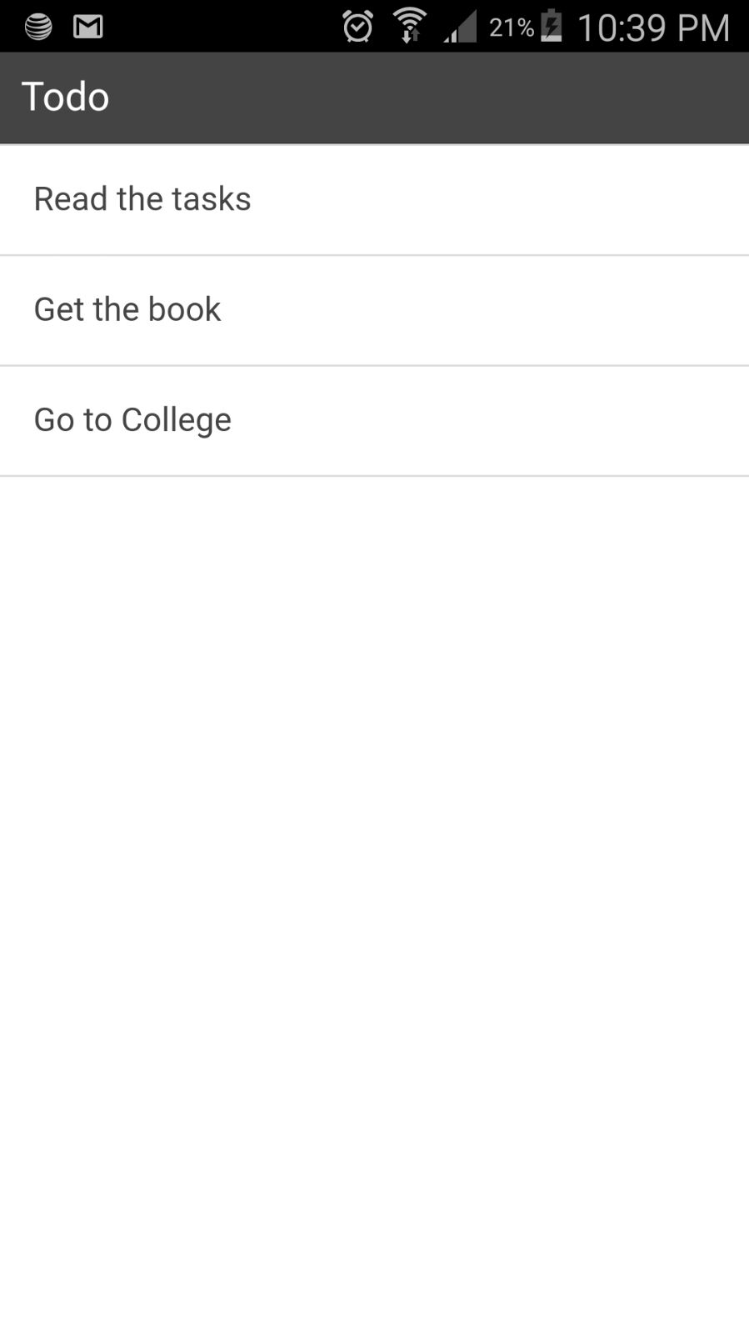
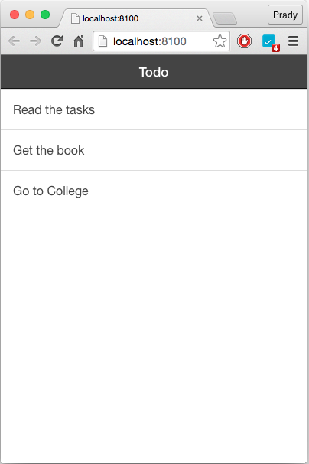
Testing your App
On Browser :
ionic serve
No need to have a device to test minor changes.
On Device :
Connect your device to the development machine and enable debugging option on your Android device and execute the following command
ionic run

Slide 24
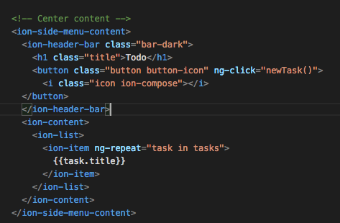
Task creation
Add a button on top of the header which calls create task function.
This is a general button with an icon.

Slide 25
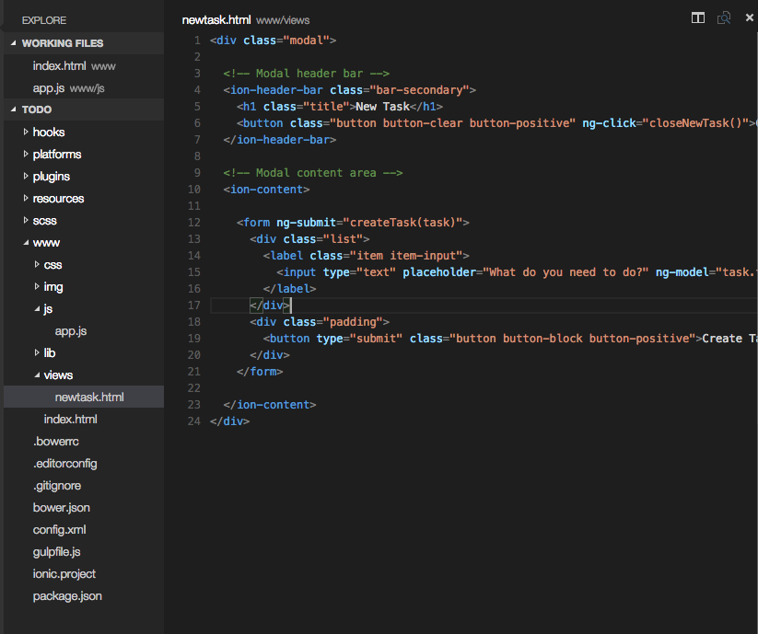
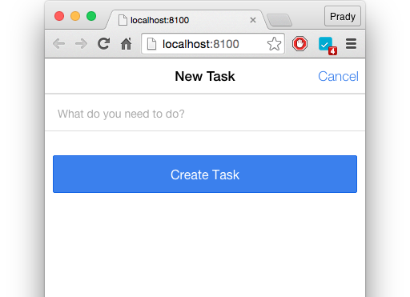
New Task Modal
Create a folder named “views” in www.
This should be the place to create all the views.

Slide 26
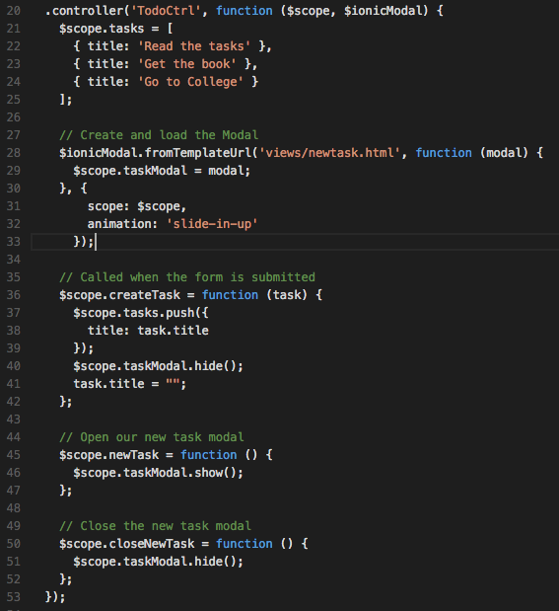
Task Creation Logic
modal controller object creation.
pushing the task into the tasks variable
Shows modal to create task
Closes modal

Slide 27
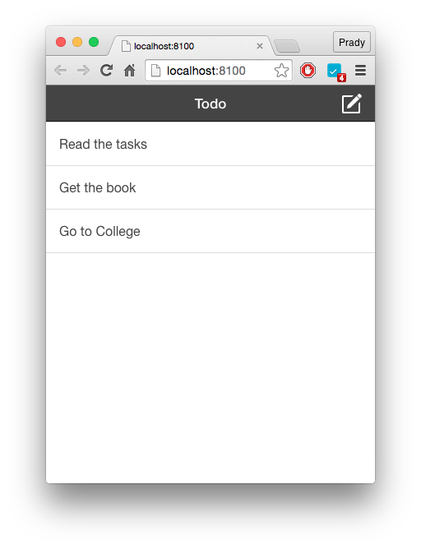
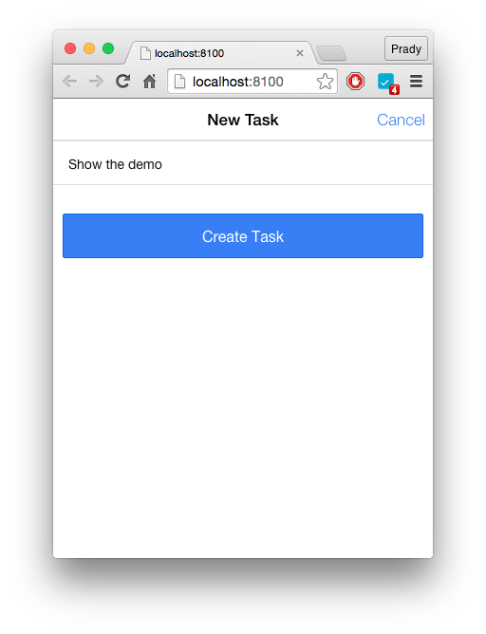
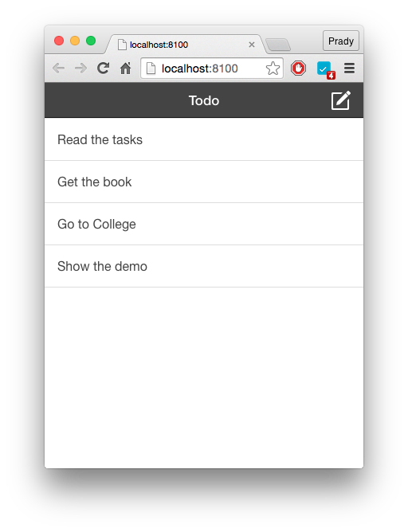
Final Run

Slide 28
Unit Testing
https://docs.angularjs.org/guide/unit-testing
Tools for testing angularjs applications:
Karma - Javascript command line tool
Jasmine - framework for testing javascript

Slide 29
Installation
Go to your angular project folder in node js terminal and execute the following commands:
npm init
npm install angular --save
npm install -g karma-cli
npm install karma-jasmine jasmine-core --save-dev
npm install karma-phantomjs-launcher --save-dev
npm install angular-mocks --save-dev

Slide 30
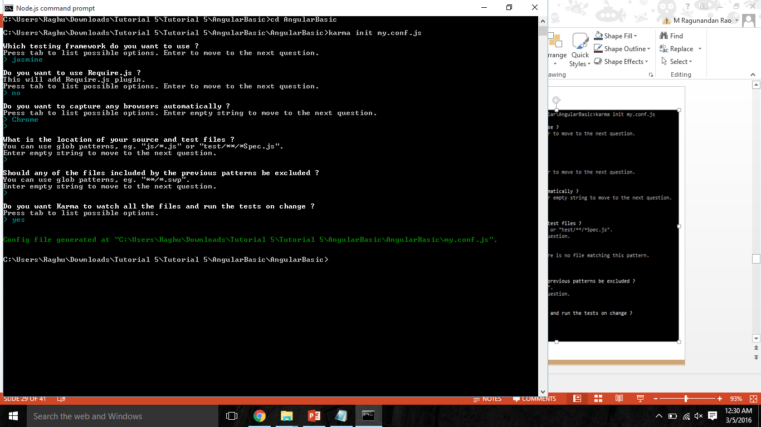
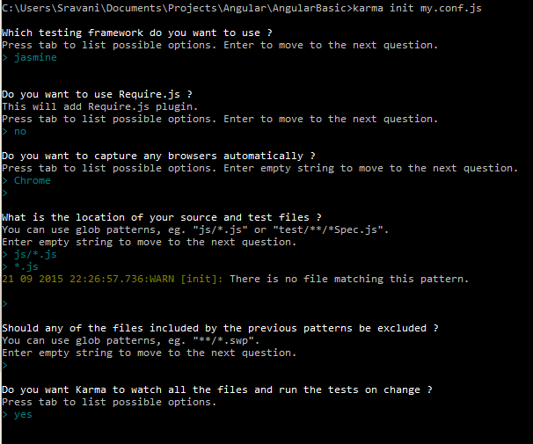
Karma Config File
Create a config file using the command:
karma init
By default it creates a config file with the name
karma.conf.js
We can specify the config file name as follows:
karma init my.conf.js
It asks questions about the testing framework,
browser as shown in the screenshot.

Slide 31
Karma Config File
Open the config file and add angular, ngMock locations to the files parameter:
files: [
'node_modules/angular/angular.js',
'node_modules/angular-mocks/angular-mocks.js',
'js/*.js',
'*.js'
]

Slide 32
Karma Config file changes - Ionic
files: [
'js/*.js',
'www/js/*.js',
'www/lib/ionic/js/ionic-angular.min.js',
'node_models/angular-mocks/angular-mocks.js'
],

Slide 33
Jasmine
http://jasmine.github.io/1.3/introduction.html
Jasmine is a behavior driven development framework for testing Javascript code.
Test Suite: A test suite begins with a call to the global Jasmine function “describe” with two parameters: a string and a function.
Test Specification: A test spec begins with a call to the global jasmine function “It” with two parameters: a string and a function.
Assertions: Expectations and Matchers are used for assertions.
eg: expect(true).tobe(true);
Actual Expected

Slide 34
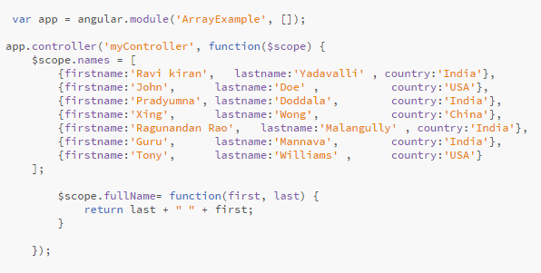
Angular JS Array Example

Slide 35
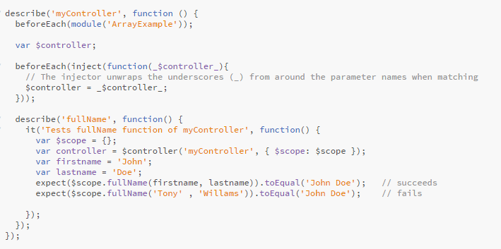
Example Test Case

Slide 36
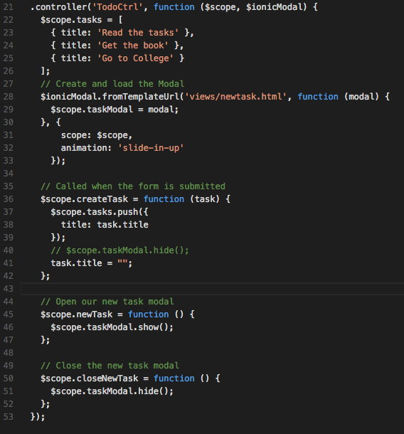
Ionic Unit Testing - Controller

Slide 37
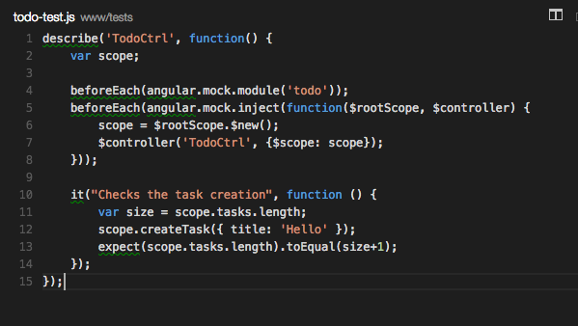
Ionic Unit Testing - Test case

Slide 38
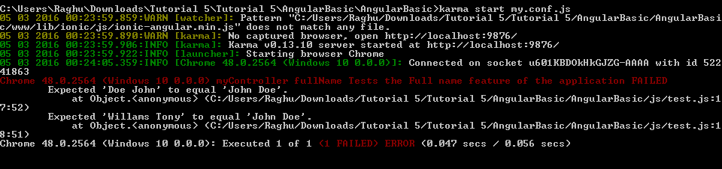
Executing Test Case
To execute the test cases use the following command:
karma start my.conf.js
It will execute test cases in all the .js files specified in the config file.

Slide 39
Note
To run any project that deals with npm, open project folder and execute
npm install
This will install all the dependencies given in package.json automatically.

Slide 40
References
http://ionicframework.com/
https://nodejs.org/en/
https://www.visualstudio.com/
Unit Testing:
https://docs.angularjs.org/guide/unit-testing
http://www.tuesdaydeveloper.com/2013/06/angularjs-testing-with-karma-and-jasmine/

Slide 41
Thank You

